Slide 1
Flower Recognition
Final Project
Notes:
Save this document with a new name before you begin work.
When adding a new slide, click on the small arrow next to “New Slide” on the toolbar. Select the layout that will best fit the content you want to add.
Change the layout of an existing slide: click the “Layout” button on the top toolbar to reformat your existing content to another master slide.
Refer to utdallas.edu/brand for specific rules on using the University logos and wordmarks.

Slide 2

Overview – Cardio Good Fitness
Dataset:
Flowers Recognition from Kaggle: (https://www.kaggle.com/datasets/alxmamaev/flowers-recognition?resource=download)
Labeled 4242 images of flowers
Five classes of flowers: chamomile, tulip, rose, sunflower, dandelion

Slide 3
Overview – Cardio Good Fitness
Supervised deep learning methods
Comparison of three models:
MobileNetV3
RestNet50
3 layers convolution model

Slide 4
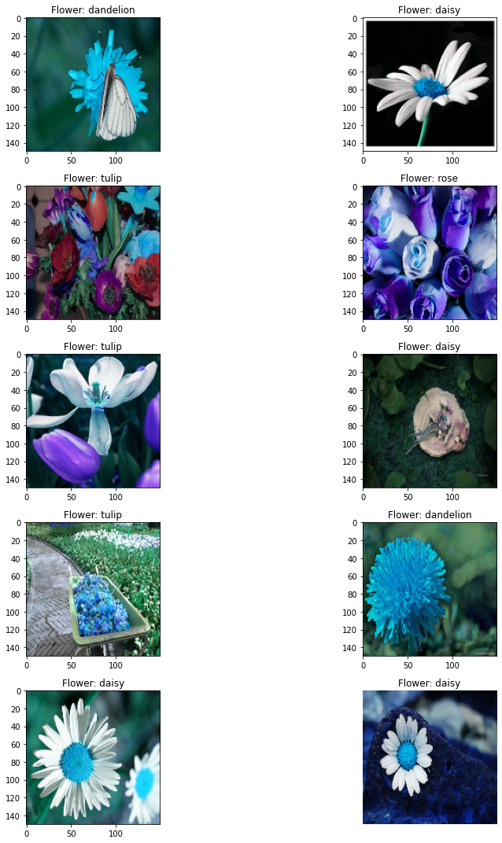
Exploratory Data Analysis (EDA)
categories=['dandelion', 'daisy', 'sunflower', 'tulip', 'rose’]
img_array=cv2.resize(img_array,(150,150))
Visualize 10 random pictures

Slide 5
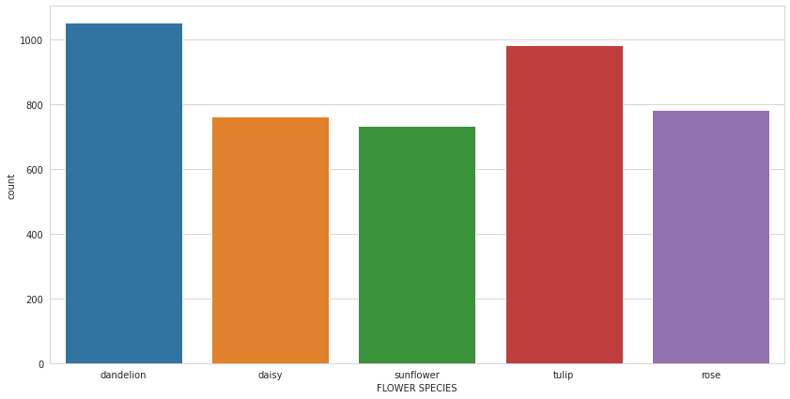
Exploratory Data Analysis (EDA) - Visualizations
Five class label distribution

Slide 6
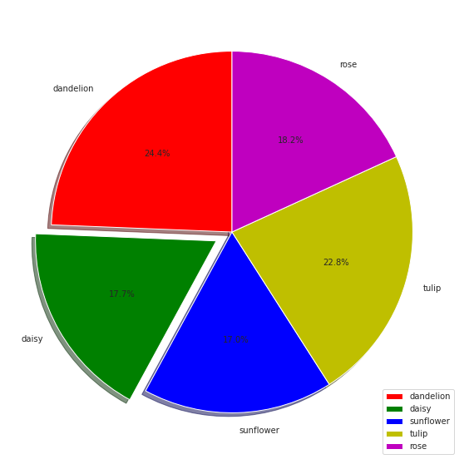
Exploratory Data Analysis (EDA) - Visualizations

Slide 7
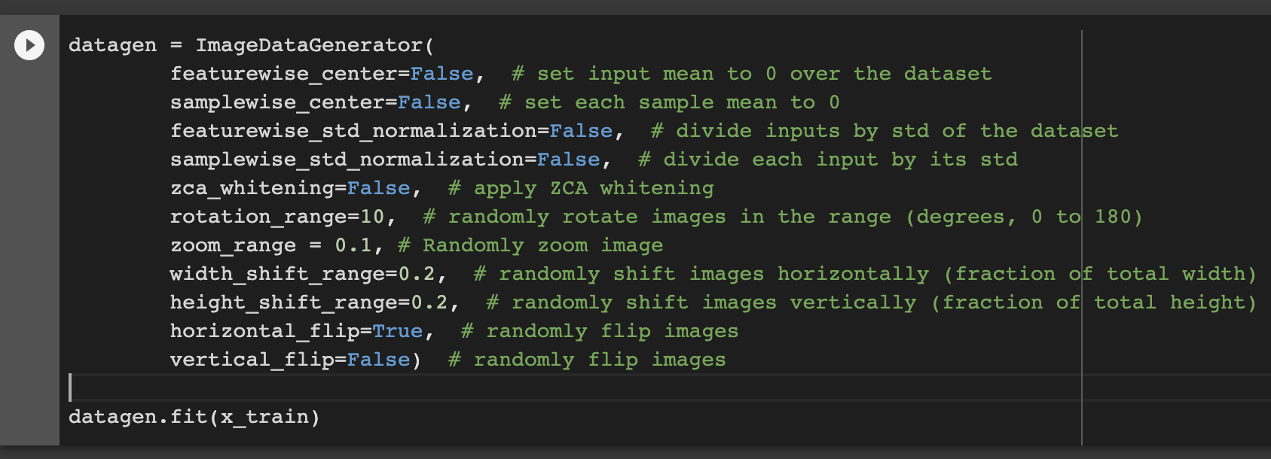
Models & Comparisons
image augmentation and randomization

Slide 8
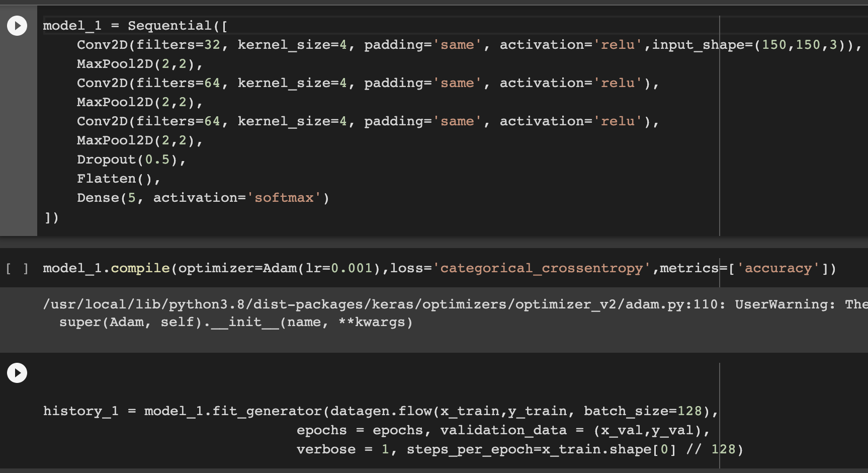
Models & Comparisons
Model 1: Three-layer convolution model

Slide 9
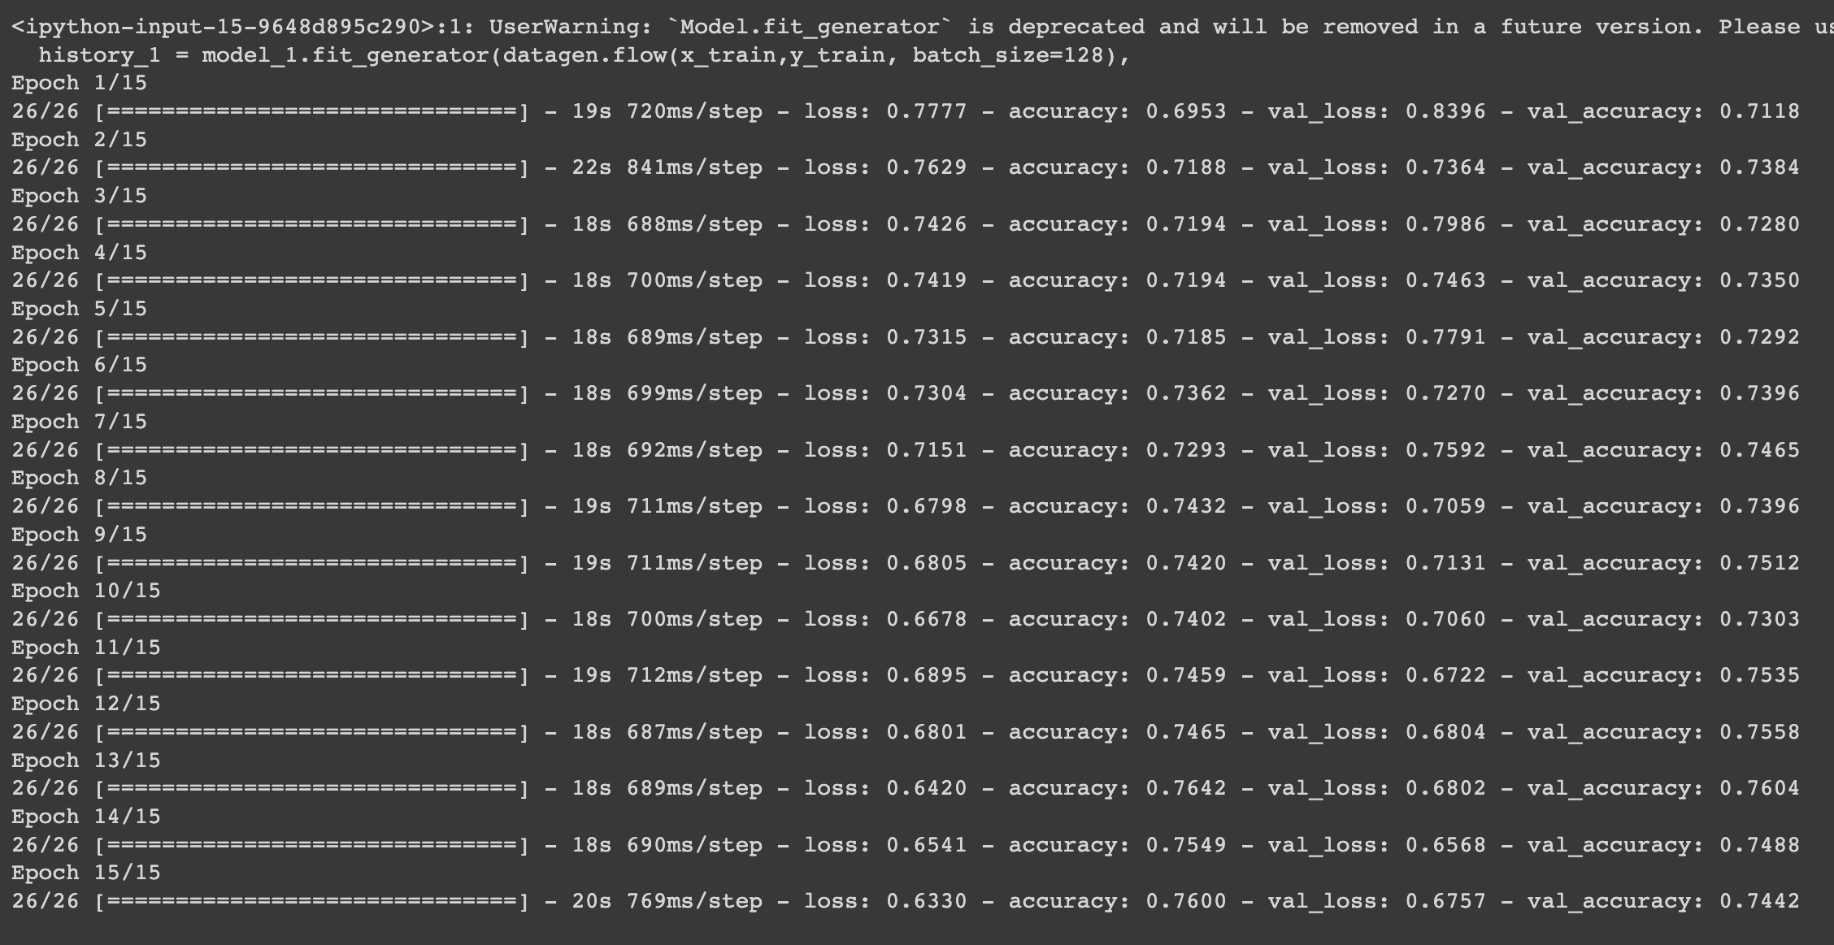
Models & Comparisons
Model 1: Three-layer convolution model

Slide 10
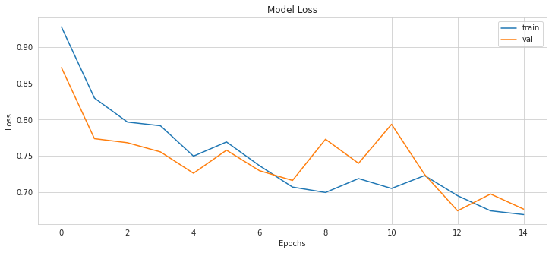
Model 1: Three-layer convolution model

Slide 11
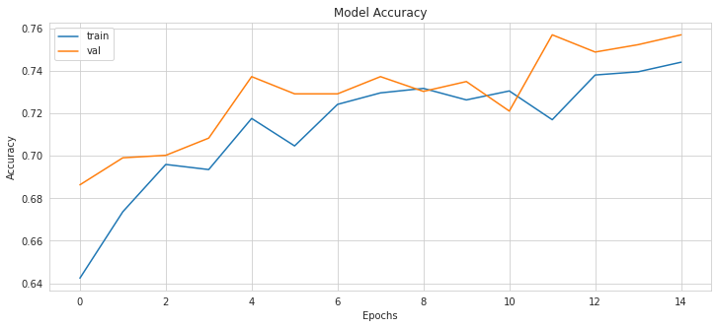
Model 1: Three-layer convolution model

Slide 12
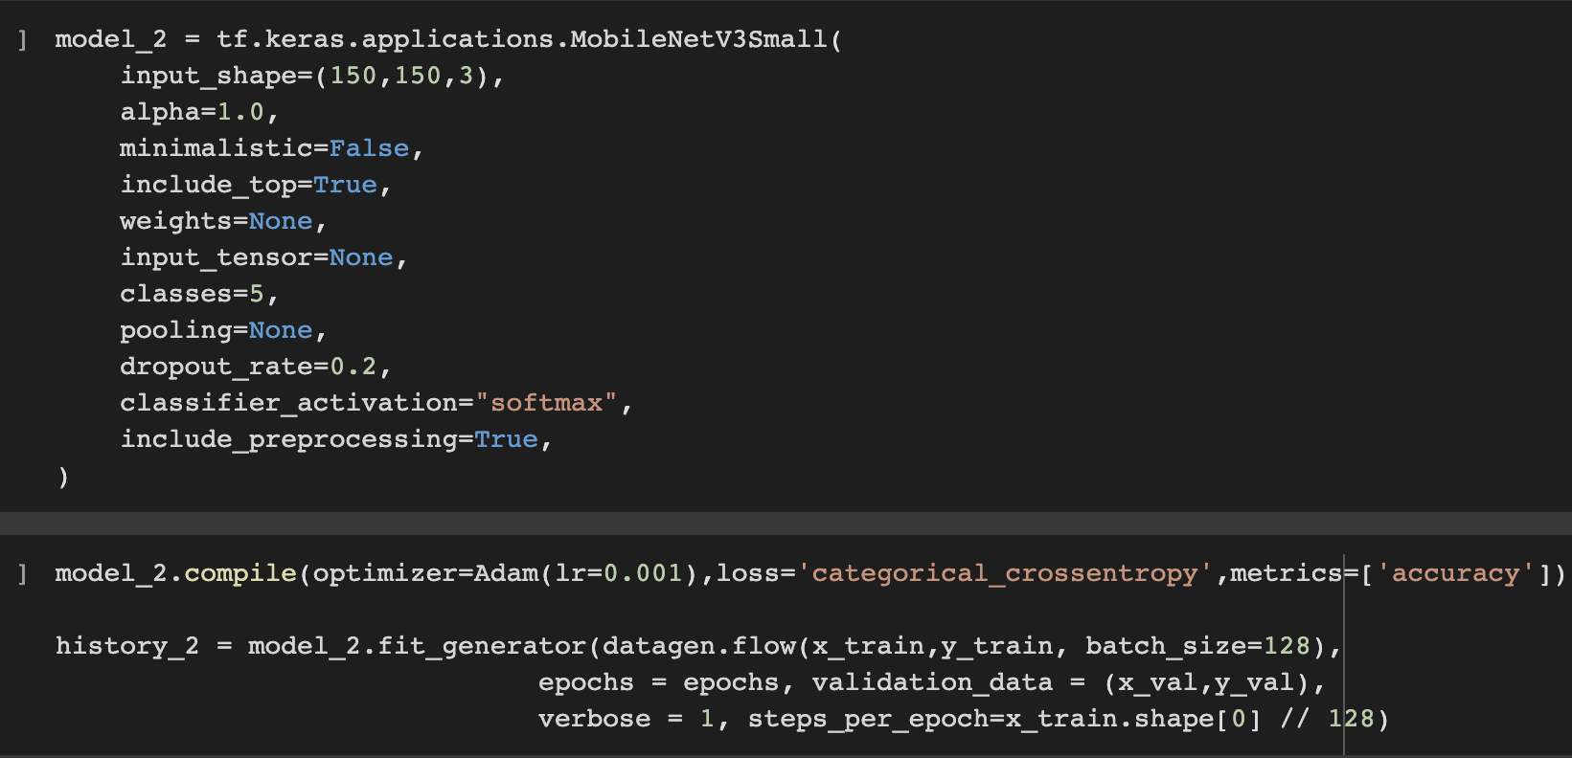
Models & Comparisons
Model 2: MobileNetV3

Slide 13
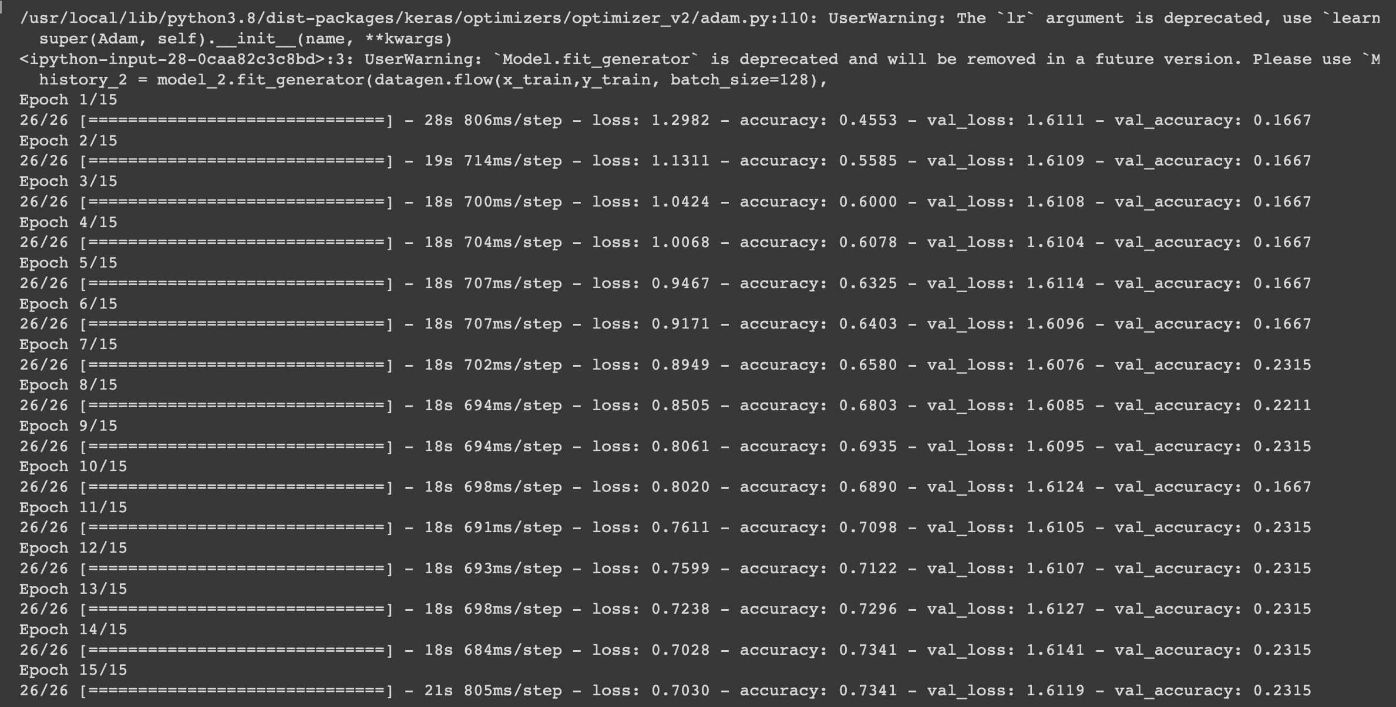
Models & Comparisons:
Model 2: MobileNetV3

Slide 14
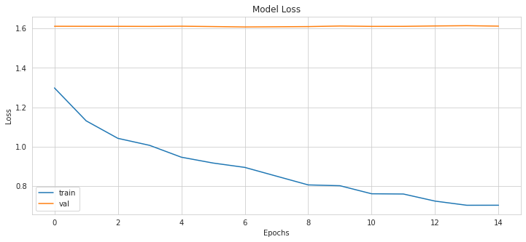
Model 2: MobileNetV3

Slide 15
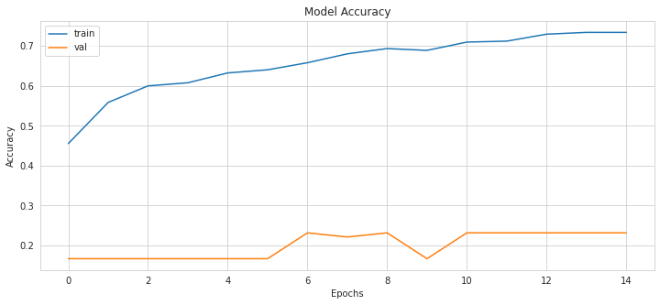
Model 2: MobileNetV3

Slide 16
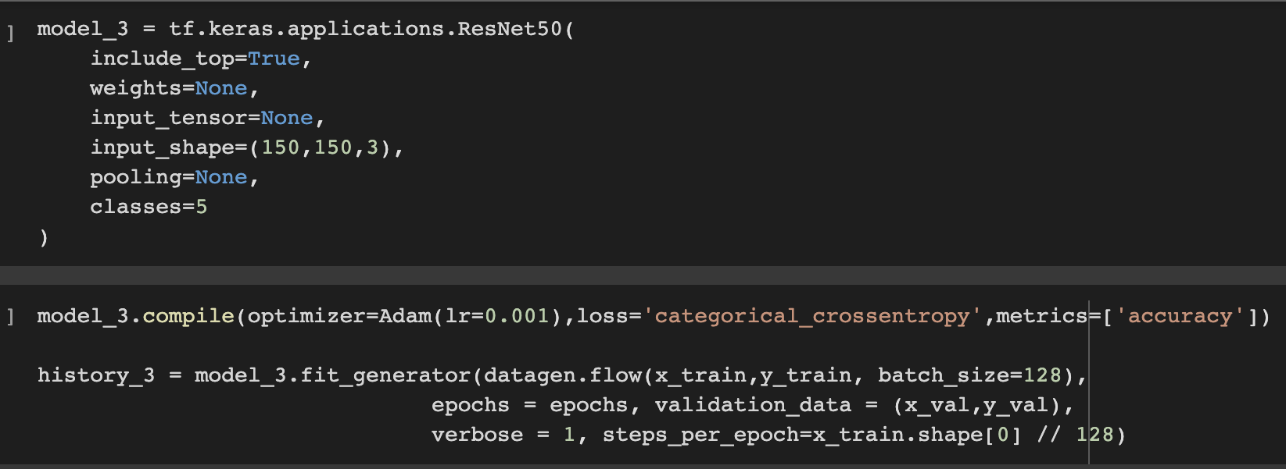
Models & Comparisons:
Model 3: ResNet50

Slide 17
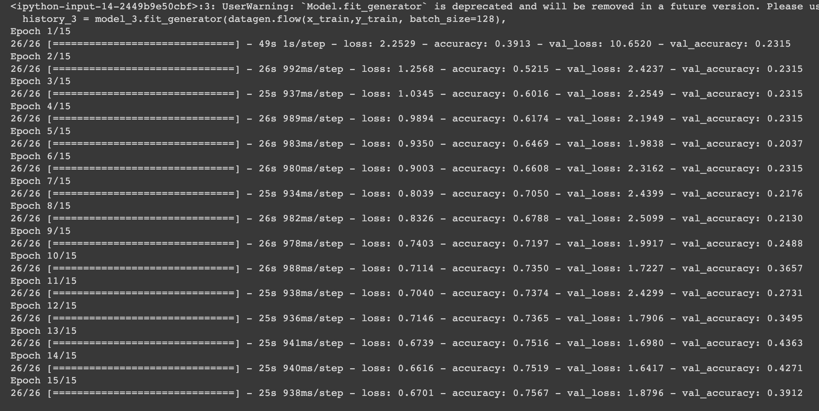
Models & Comparisons:
Model 3: ResNet50

Slide 18
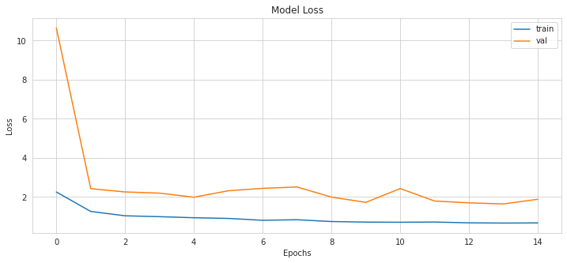
Models & Comparisons:
Model 3: ResNet50

Slide 19
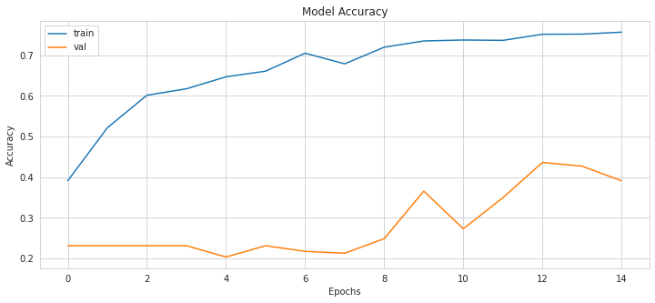
Models & Comparisons:
Model 3: ResNet50

Slide 20
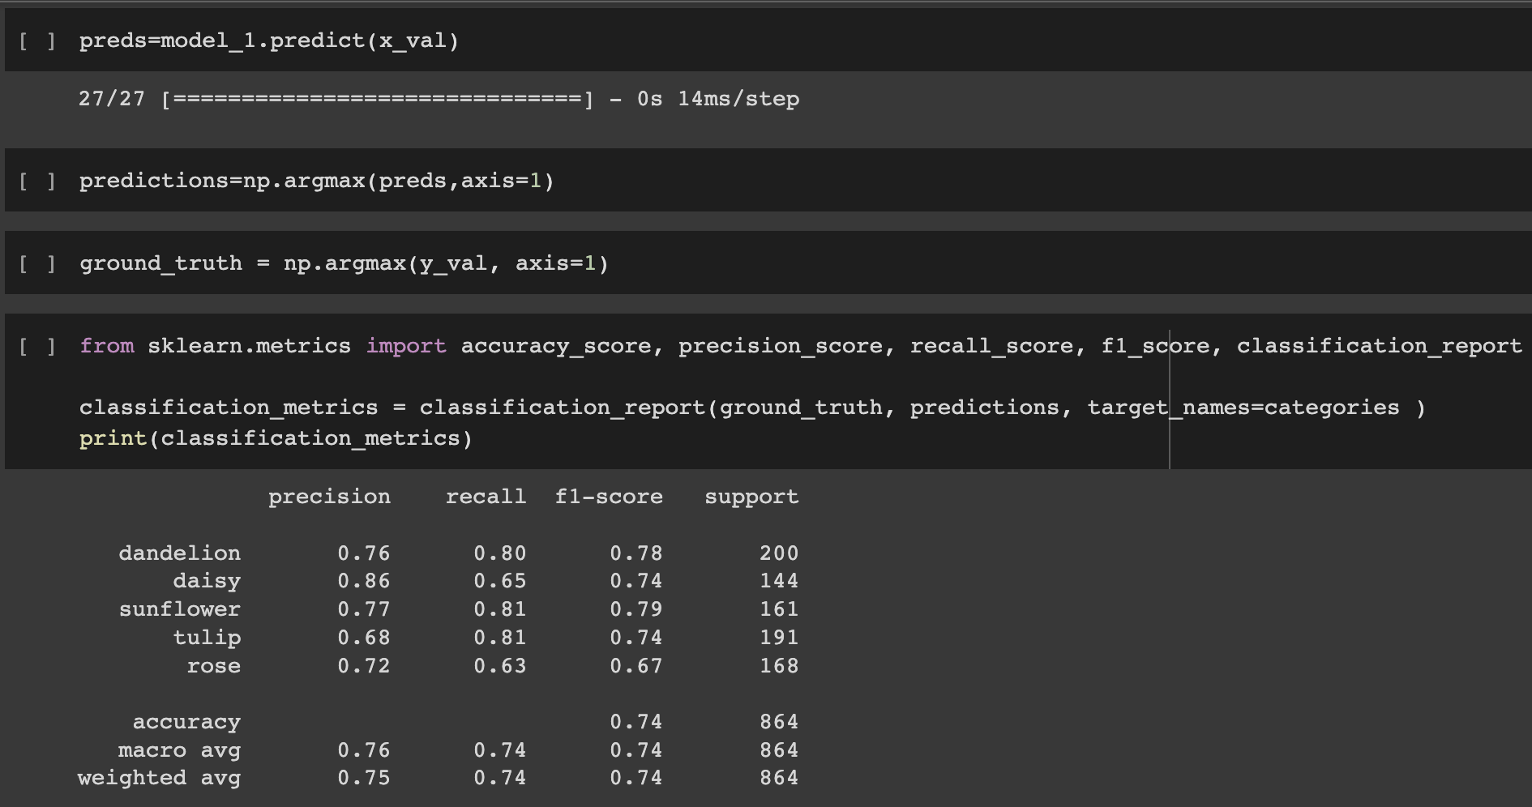
Results & Analysis

Slide 21
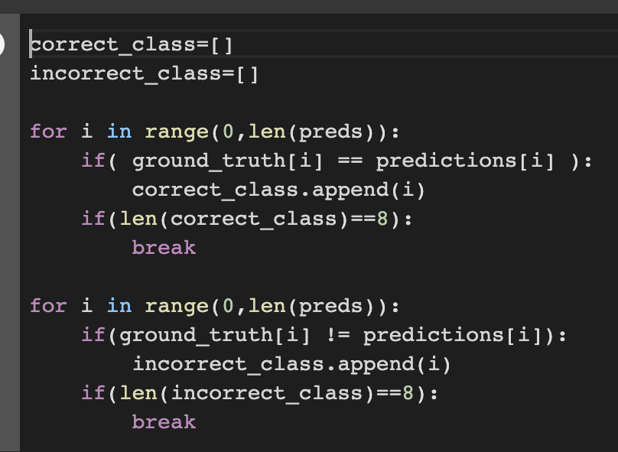
Results & Analysis – Correct & Incorrect Predictions

Slide 22
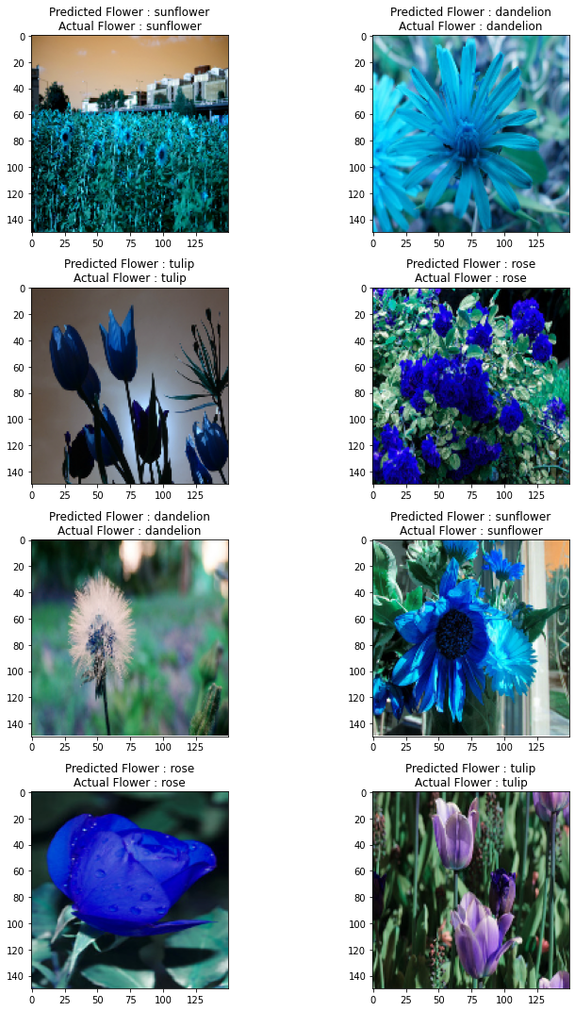
Results & Analysis:
Correct Predictions

Slide 23
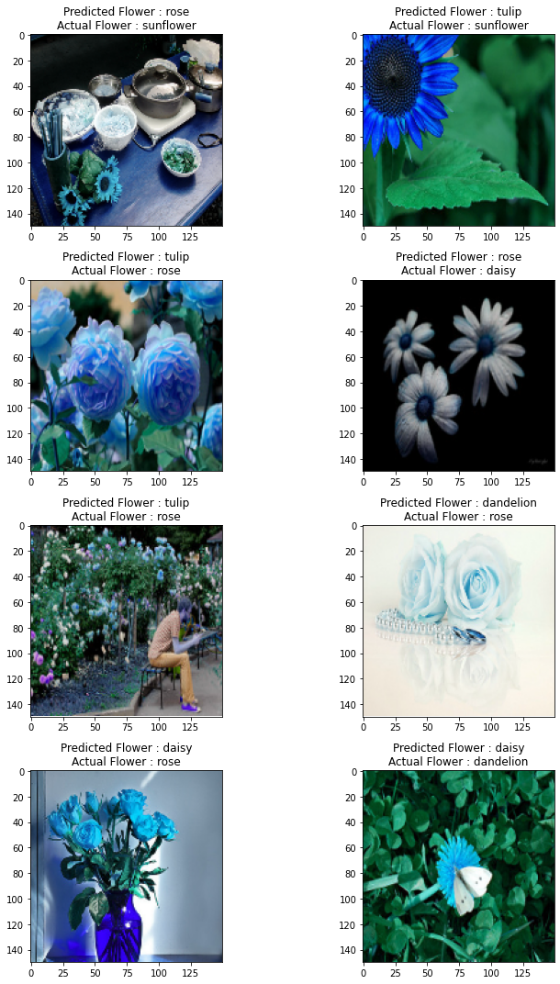
Results & Analysis:
Incorrect Predictions

Slide 24
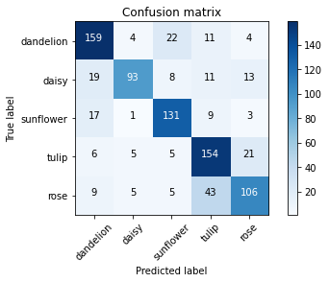
Models & Analysis

Slide 25
Conclusion
Overfitting : ResNet50 model and MobileNetV3 model
Three-layer convolution model
Accuracy and time consuming

Slide 26
Thank You !
DTSA 5510
Notes:
Save this document with a new name before you begin work.
When adding a new slide, click on the small arrow next to “New Slide” on the toolbar. Select the layout that will best fit the content you want to add.
Change the layout of an existing slide: click the “Layout” button on the top toolbar to reformat your existing content to another master slide.
Refer to utdallas.edu/brand for specific rules on using the University logos and wordmarks.

